Slide 1

SOLUTION AND DESIGN ARCHITECTURE
CGC_REBOUNDER

Slide 2
Formulae
Average bpm=60 to 100 beats per minute
So if Average bpm will become low or high
Instant Notification will be send to the attached devices
For Verification of Best Result.
Counted Pulse: _____ beats in 10 seconds x 6 = _____ beats/minute
Weekly Report will be Generated and send to the Consult Doctor
For Further Guidelines and Consultancy

Slide 3
ALGORITHM
Basically It works on the Basic Functionality of Pulse Sensor(for initial data )
We just have Club Up their Functionality with ESP 8266 which shows the Output in our screen
Weekly Report will be Generated
As well as Immediate Emergency Notification

Slide 4
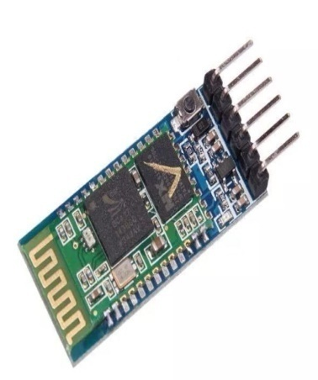
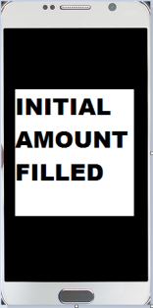

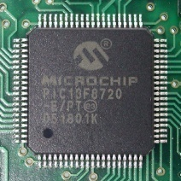
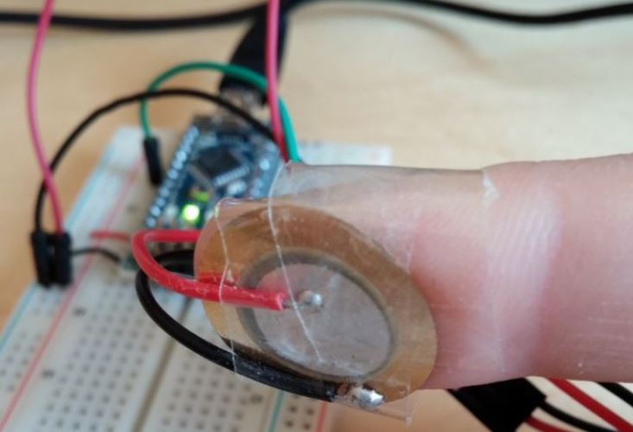
ARCHITECTURE DESIGN
ESP 8266
Secure communication
Secure communication
Microprocessor
USER
Application
Elder System

Slide 5
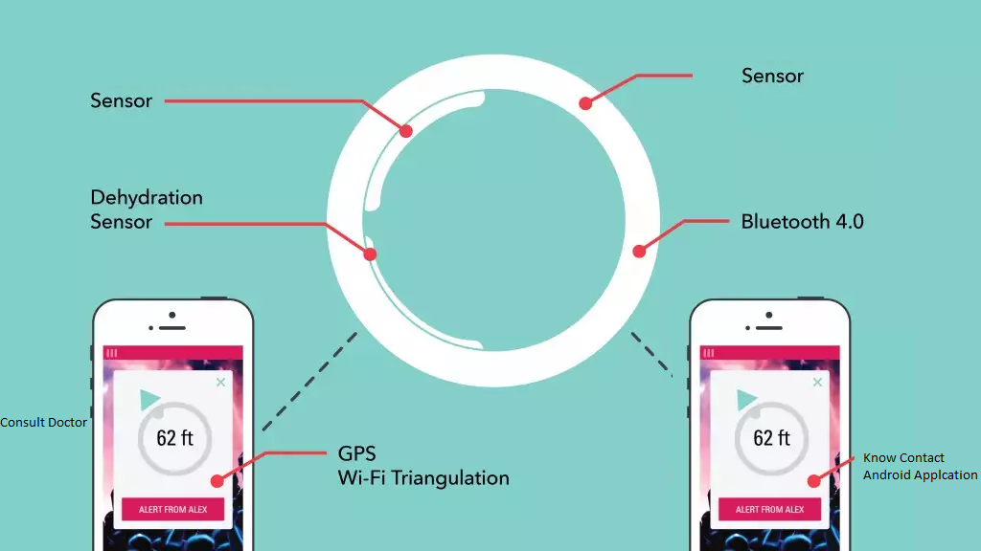

Slide 6
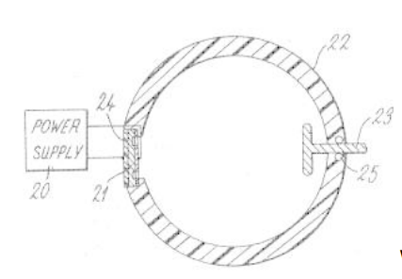
USE-CASE MODEL
A Band Shaped Embedded Structure with different sensors.
All sensor data will be send to android application using HC 05(Bluetooth Chipset).
Later on Data will be send to Known Contact as well concerned Doctor.
Weekly Report will be Generated and Send to the Known Contact as well concerned Doctor .

Slide 7
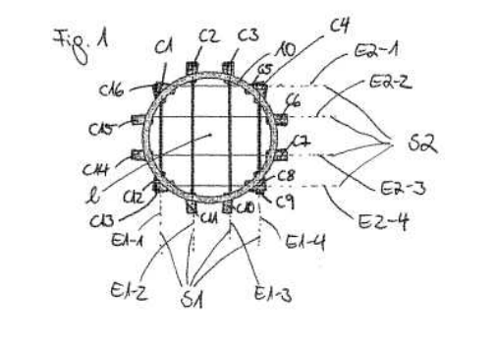
USE-CASE MODEL
This is how the Ring is divided in
Particular Quarter in order to
Get the Exact Report of Pulses
Being beating

Slide 8
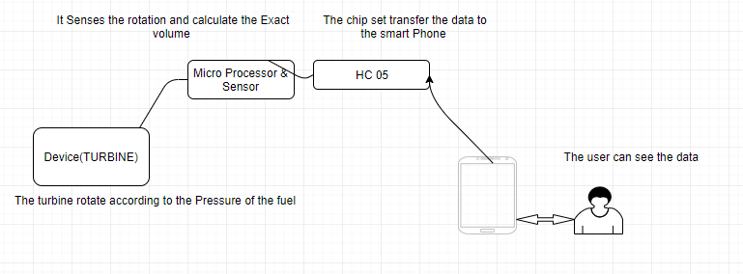
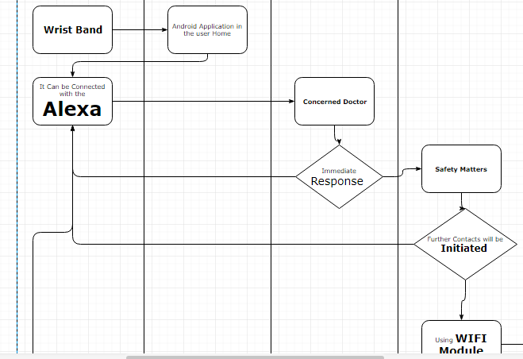
DATA MODEL

Slide 9
WORKING
Open The App And Click On Start
Sharing Of Data
Android API
WiFi Module
ESP 8266
Embedded system data
Elder System
Pair The Device
Collecting The Data

Slide 10

Thank You
CGC_REBOUNDER

